Slide 1
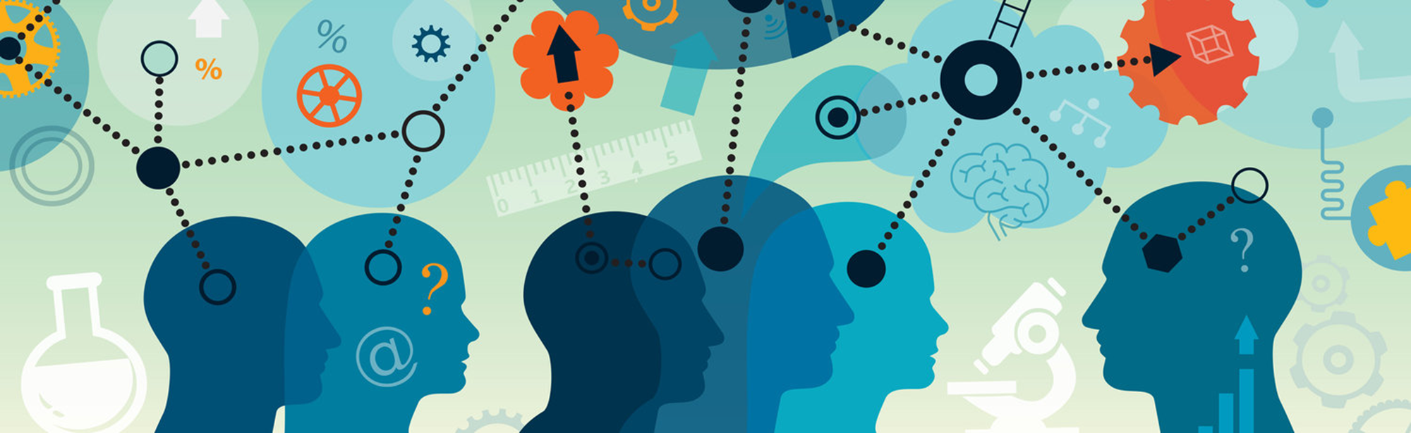
Ethics, Psychometrics and Personality

Slide 2
Reading for this lecture
Research methods in Psychology, Chapters 3 and 4

Slide 3
Ethics

Slide 4
Ethical issues in running Psychological research
Risk / Benefit analysis
Acting with integrity
Acting fairly / justly
Showing respect

Slide 5
Discussion: Risk vs benefits
Social problem: there is an ongoing dispute as to whether therapy can create false memories of childhood trauma.
A researcher decides to try to get people to “recover” a memory that is known to be false, using methods reported by therapists, such as guided imagination.
What are the risks vs benefits of this kind of research?
What would decrease the risk?
What would increase the benefit?

Slide 6
Discussion 2: Respect
For the purposes of research, is it ever justified to lie or otherwise deceive participants?
Hint: Think about different levels or degrees of deception

Slide 7
From principles to guidelines
Experiments involving human (or animal) participants require ethical approval (by a suitably appointed ethics committee).
For your group project, you will have to get ethical approval, before you recruit anyone to take part in your research.

Slide 8
The ethics form should detail:
what will happen to the participants
and where necessary, to justify these (i.e. Benefit vs risk).
the level of anticipated harm / risk
and what steps taken to reduce these
How participant’s rights are protected
Informed consent
Treated with respect (including not being deceived unnecessarily)
Right to withdraw
Anonymity
Brief and Debrief

Slide 9
Ethical process for your group projects
Your ethics approval request should detail
Confirmation of who your sample will be
An outline of your research procedure
Explanation of how you have considered and dealt with potential ethical concerns
The nature of the data you plan to collect
A copy of the Brief and Debrief you plan to show participants
A consent form.

Slide 10
Informed consent
Participants should the necessary information to judge whether they wish to participate.
What will happen to them?
What is expected of them?
What are the potential harms / risks?
What are their rights? (more later)
What rewards (if any) are on offer?
Note: the level of information needs to be balanced against the aims of the experiment (i.e. the potential benefits)

Slide 11
Treated with respect
The language used with the participant should be appropriate.
The experimenter should not be judgmental / authoritarian (etc).

Slide 12
Right to withdraw
A participant has the right to withdraw their consent at any point.
i.e. even having signed a consent form, they can stop.
They can even request their data not be used after the end of the experiment.

Slide 13
Right to Anonymity
Participants have the right to remain anonymous in all aspects of the research, in particular
During dissemination of the results.
On digital records.
In fact under GDPR legislation, there are serious penalties if identifying information is recorded without permission, or stored / shared inappropriately.

Slide 14
Brief
The aim of the brief is to tell participants what is going to happen here possible, why), so that they can give informed consent.
There is a balance between giving enough information, and giving information that may affect the outcome of the study.

Slide 15
Debrief
The aim of the debrief is to tell participants the purpose of the experiment once it is over.
Remember, if there are multiple conditions, they may not have experienced all of them.

Slide 16
Psychometrics

Slide 17
Psychometrics
Psycho = “of the mind” (mental) + metric = “measurement”
Psychometrics is concerned with measurement of mental constructs, and theories that explain the pattern of findings.
Measurement is a systematic procedure by which numerical scores are assigned to a set of objects, where these scores represent the characteristic of interest.

Slide 18
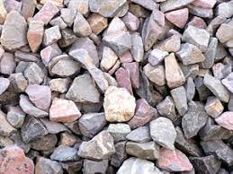
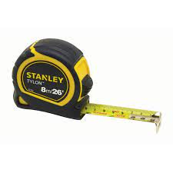
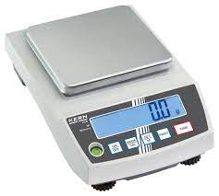
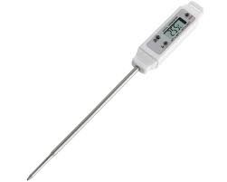
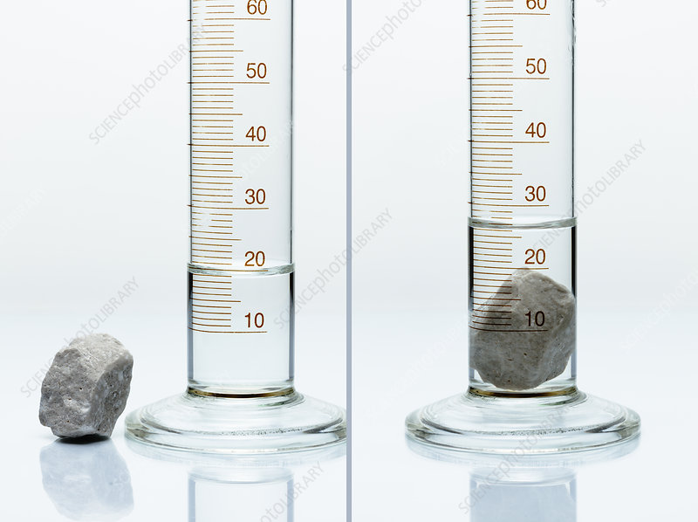
Measurement
Q: How could you find out which is the largest stone by volume?
These are tools for converting physical properties of the stones into a numerical value that can be used to distinguish between them.

Slide 19
Two key properties tools need to be useful.
Reliability
They give the same answer when used twice.
They give the same answer if two different versions of the tool are used.
Validity
They accurately measure the right physical property.
i.e. if you want to measure volume, they measure volume, not weight, or temperature.

Slide 20
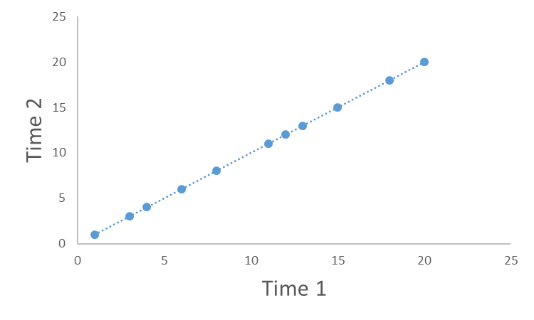
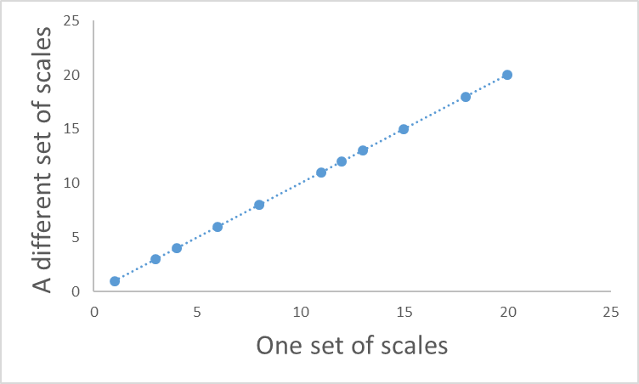
What would reliability look like?
Test – retest reliability
Parallel forms

Slide 21
A crucial point about reliability and validity.
A measure can be reliable without be valid.
e.g. scales measure weight accurately, but this does not make them a good measure of temperature.
A measure that is not reliable is not valid.
If a measure gives a different answer each time (is unreliable), then the reading you get can’t be a valid measure of anything
i.e. a faulty set of scales does not a valid measure of weight.

Slide 22
Psychometrics is commonly concerned with relatively stable constructs that people vary on (called “traits”).
e.g. Personality (e.g. extraversion, openness to experience etc).
Ability (e.g. verbal abilities, musical ability, general intelligence)
Beliefs / Attitudes (e.g. political orientation, spirituality)
But it can also measure more temporary “states”
e.g. Mood, stress

Slide 23
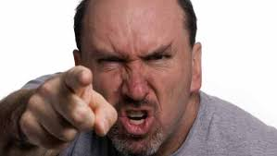
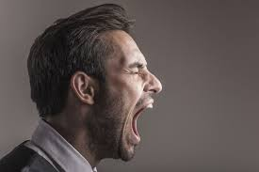
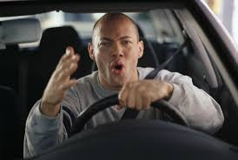
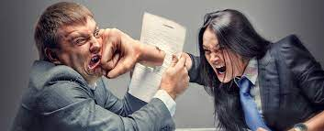
Remember this slide?
Psychological constructs are inferred from observable behaviours
Aggression

Slide 24
How could we develop a tool that provided a reliable measure of aggression?
Behavioural observation of the behaviours we think are caused by aggression
Self-report of those behaviours

Slide 25
But how do we know if it reliable and valid?
1: Reliability
Getting the same score twice.

Slide 26
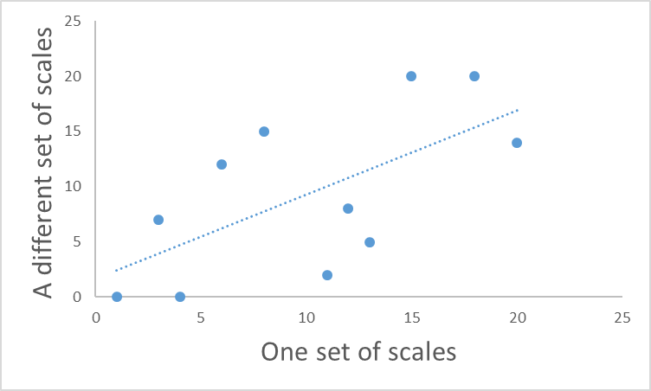
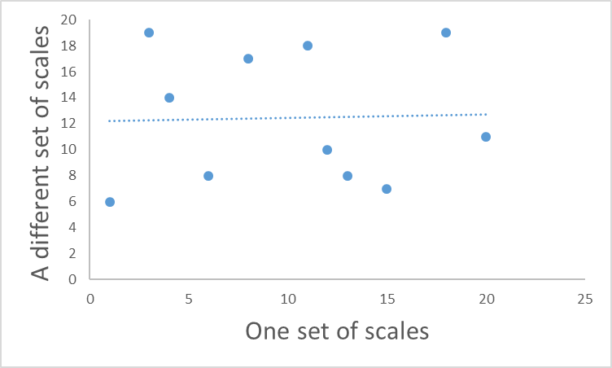
Back to reliability
Perfect reliability
One score is exactly the same as the other.
Knowing one score tells you exactly what the other score will be.
Zero reliability
One score is completely unrelated to the other.
Knowing one score tells you nothing about what the other will be
?

Slide 27
Reliability
Another way of expressing the concept of reliability, is predictability.
Here, one score perfectly predicts what the other score will be.

Slide 28
Scatterplots and correlations
A scatter plot is the figure you get when you plot the value of two observations against each other.

Slide 29
Scatterplots and correlations
The blue dotted line represents the best “fit” between the observations.
Notice that this line goes up.
(Has a positive slope)
This means that as one measure goes up, so does the other one.

Slide 30
Scatterplots and correlations
The “fit” of the line is how far away the dots fall from the best possible line.
Here we can measure how far away each point is (the red lines), and add them up.
The smaller the total, the closer on average the dots are to the line.
If the dots fell exactly on the line, the total would be zero – a perfect correlation.

Slide 31
Correlation values
Value | Interpretation
1 > r > 0.6 | A strong positive correlation: as one variable increases, so does the other.
0.6 > r > 0.4 | A moderate positive correlation
0.4 > r > 0.2 | A weak positive correlation
-0.2 < r < 0.2 | Weak to non-existent correlation
-0.4 < r < -0.2 | A weak negative correlation
-0.6 < r < -0.4 | A moderate negative correlation
-1 < r < -0.6 | A strong negative correlation: as one variable increases, the other decreases.

Slide 32
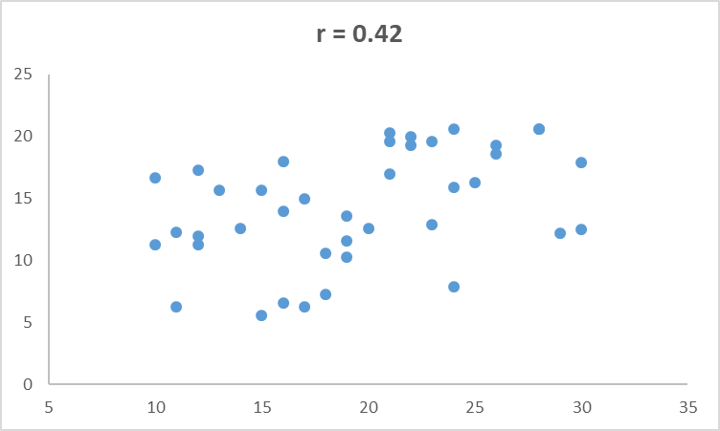
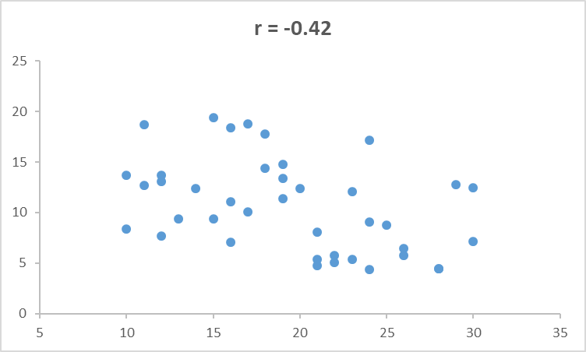
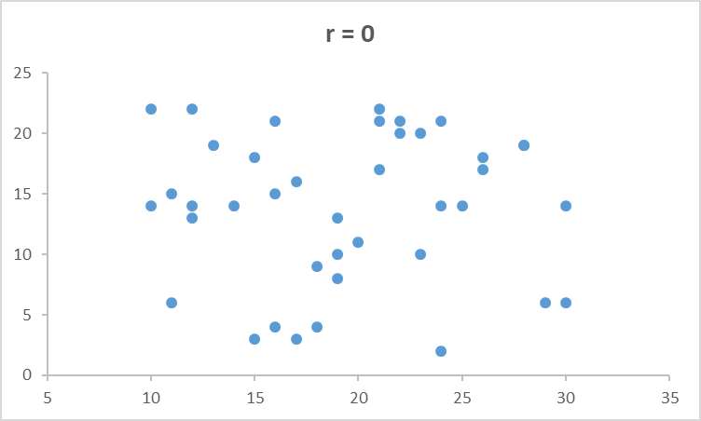
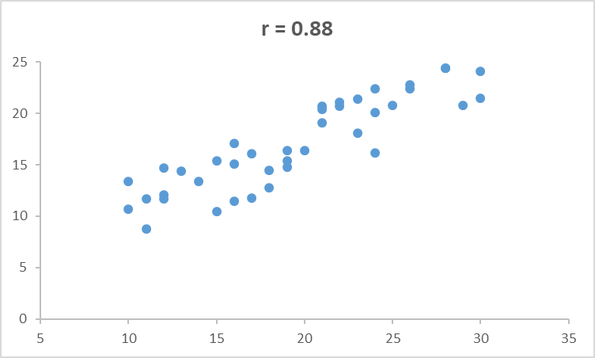
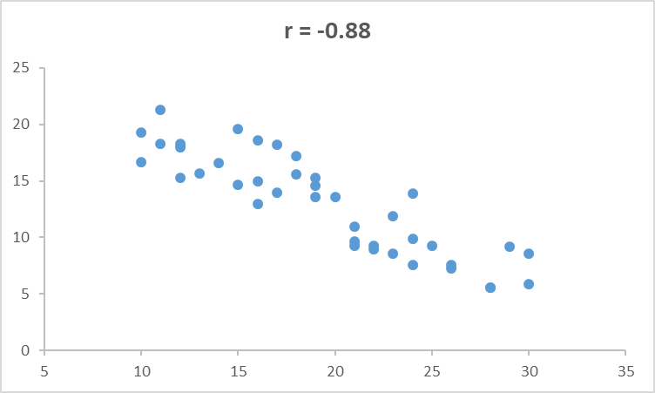
Positive vs negative correlations:

Slide 33
Some limitations of (simple) correlations
1: They only measure the linear relationship between two variables.
2: Their value depends upon the variation in each variable
- this is related to the sample you measure
3: They require that each variable is (roughly) normally distributed
- they are affected by extreme values.

Slide 34
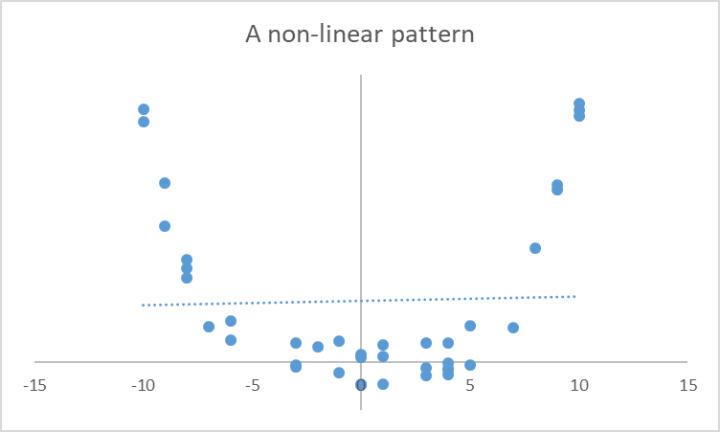
Correlations only measure linear relationships
Here there is a clear relationship between the two variables – just not a linear one.
Consequently a single straight line will never “fit” the data very well – the correlation is nearly zero here.

Slide 35
The effect of restrictions of range
r = - 0.2
A restricted range
Here the whole sample shows a moderately
positive correlation.
But if we restrict the range (to only high-scorers on the
Test), the correlation value reduces. This is because there
isn’t so much variation in the test scores in this sample.

Slide 36
The effect of restrictions of range
r = - 0.16
Here the whole sample shows a moderately
positive correlation.
The same happens if we only look at the low scorers.

Slide 37
The effect of extreme values
r = 0.61
Here the whole sample shows a moderately
positive correlation.
Picking only the highest and lowest scores
increases the correlation. This is because the extreme
scores don’t overlap as much as those in the middle.

Slide 38
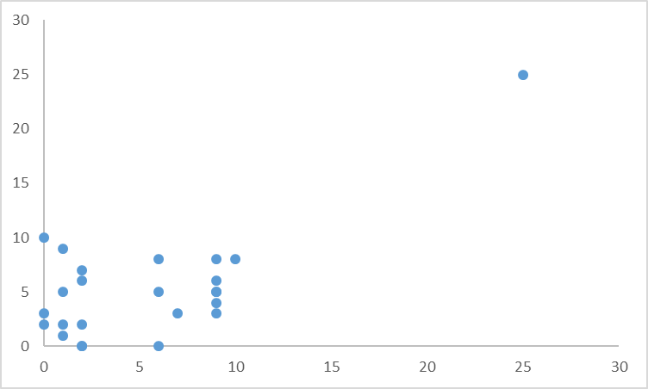
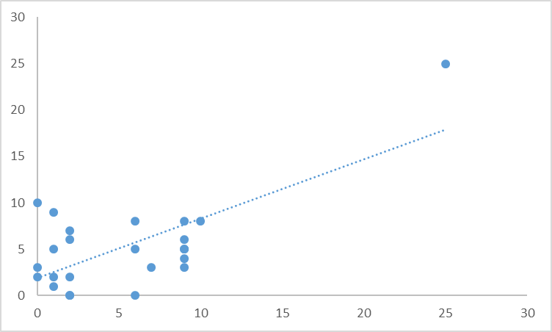
The effects of extreme values
r = 0.01
r = 0.61
This set of points represents a near zero correlation.
Adding a single extreme value increases the correlation value.

Slide 39
Reliability of multiple-item scales.
So, we have focused on two (overall) scores
Either time 1 vs time 2 (test-retest reliability)
Or test 1 vs test 2 (parallel form reliability).
We can extend this to multiple measures and use the results to increase reliability (and also validity – see later).

Slide 40
Increasing the reliability of a measure.
Any test score obtained consists of two components
Score obtained
=
the true score
+/-
noise
Other factors that might influence the outcome
e.g. motivation, attention, understanding instructions etc.
The underlying construct being measured.

Slide 41
Increasing the reliability of a measure.
Any test score obtained consists of two components
Score obtained
=
the true score
+/-
noise
Other factors that might influence the outcome
e.g. motivation, attention, understanding instructions etc.
The underlying construct being measured.
If the score obtained is mostly the true score, with little noise, then the score obtained will be reliable!

Slide 42
Increasing the reliability of a measure.
Any test score obtained consists of two components
Score obtained
=
the true score
+/-
noise
Other factors that might influence the outcome
e.g. motivation, attention, understanding instructions etc.
The underlying construct being measured.
If the score obtained is mostly noise, then the score will be unreliable!

Slide 43
Increasing the reliability of a measure.
Any test score obtained consists of two components
Score obtained
=
the true score
+/-
noise
Other factors that might influence the outcome
e.g. motivation, attention, understanding instructions etc.
The underlying construct being measured.

Slide 44
What if we take multiple measures
1
Score obtained
=
the true score
+
noise
2
Score obtained
=
the true score
-
noise
3
Score obtained
=
the true score
+
noise
4
Score obtained
=
the true score
+
noise
5
Score obtained
=
the true score
-
noise
Average
Score obtained
=
The true score
+
1 / 5 noise
Notice that the average score has less noise in it. So it is MORE reliable.

Slide 45
Therefore
Multiple measures (of the same thing) give you a more reliable measure.
This is why most scales and tests contain multiple items to measure the thing they are interested in.
e.g. personality tests, ability tests etc.

Slide 46
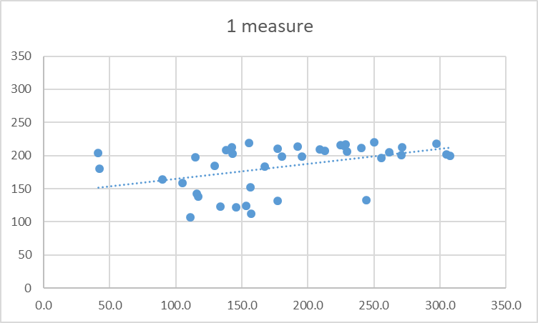
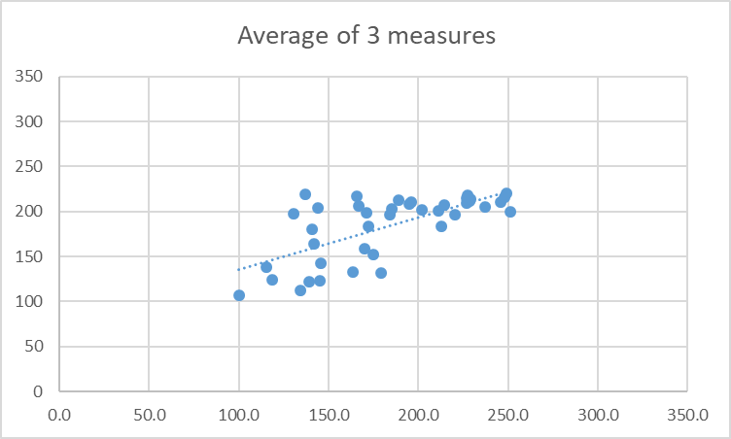
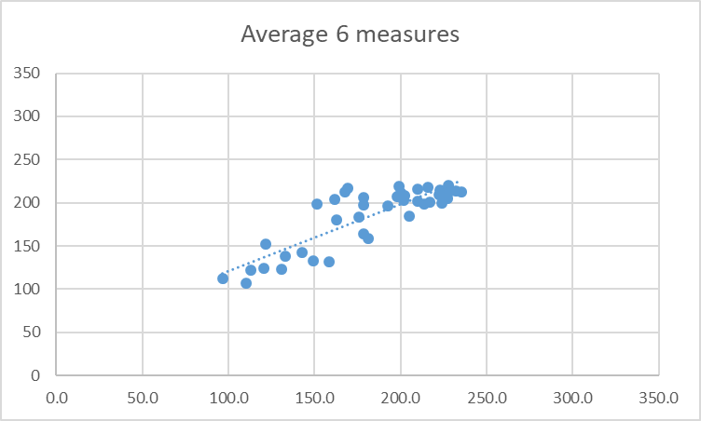
If you have enough measures, you can get an accurate reading, even if each individual measure is noisy.
r = 0.43
r = 0.68
r = 0.85
True score
True score
True score
One moderately reliable measure
Average of 3 moderately reliable measures
Average of 6 moderately reliable measures
Notice, by adding (or averaging) multiple measures, as well as higher correlations, there are fewer outliers, and the slope becomes more accurate.

Slide 47
The effect of averaging across more predictors is an example of the law of small numbers.
The “law of small numbers” is the false belief that small samples provide a good representation of the population they come from.
Examples:
…that restaurant is rubbish because my friend had a bad experience.
…this course will be boring because the first lecture was dull.
…University X will be great, because their Open Day was great.
ALL THESE EXAMPLES HAVE A SAMPLE SIZE OF 1.

Slide 48
These examples are NOT necessarily true.
Small samples result in averages that are more likely to be further away from the true (population) average than averages from larger samples.
Because small samples are noisier measures!

Slide 49
In the example on the next slide.
In the next figure, I randomly generated guesses that were normally distributed (bell-curve) with a true average of 200, ranging from -100 to +500.
I then took averages of 10, 20, 40, 80, 160 or 320 guesses.
I did this 10 times to see how variable the averages were.

Slide 50
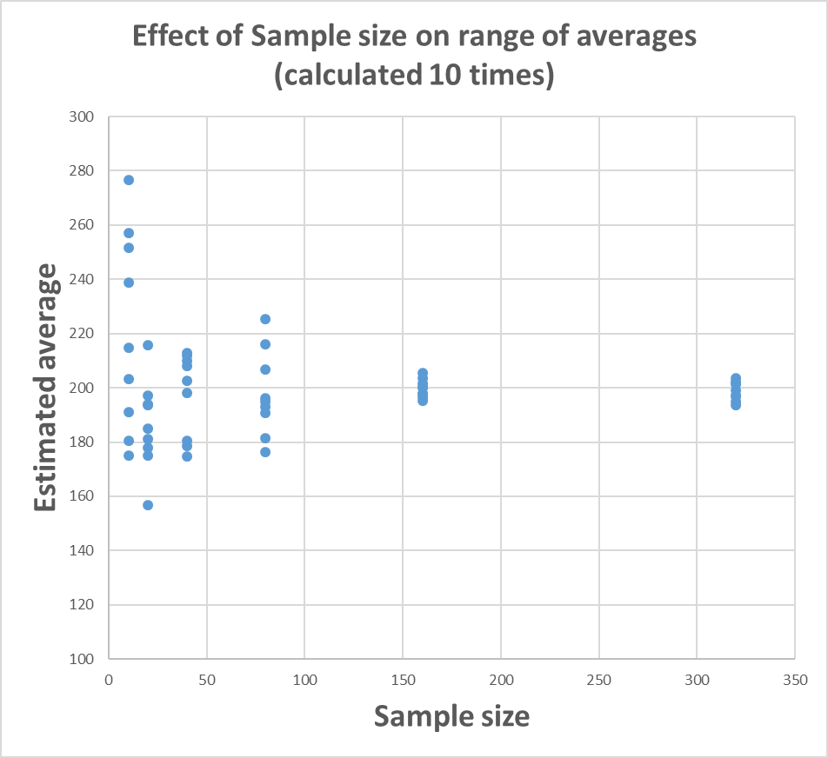
Small samples likely to give more extreme estimates of true average
10 estimates from small samples (n = 10)
10 estimates from large samples (n = 320)
True average = 200

Slide 51
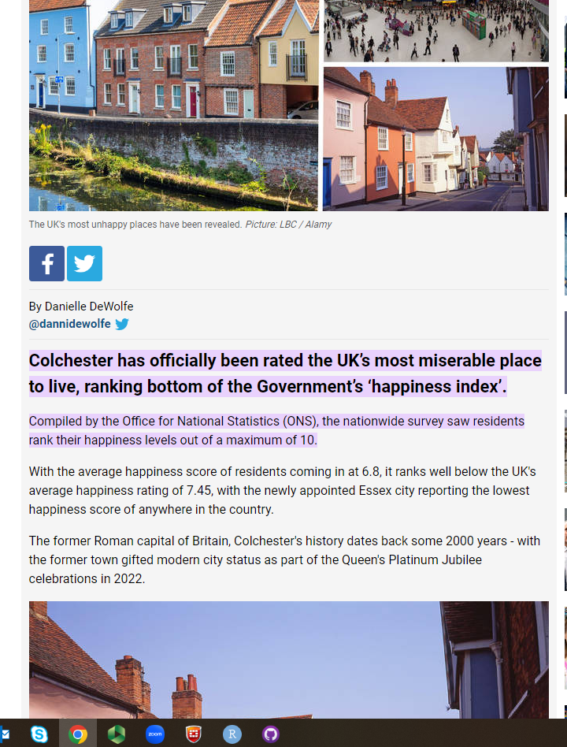
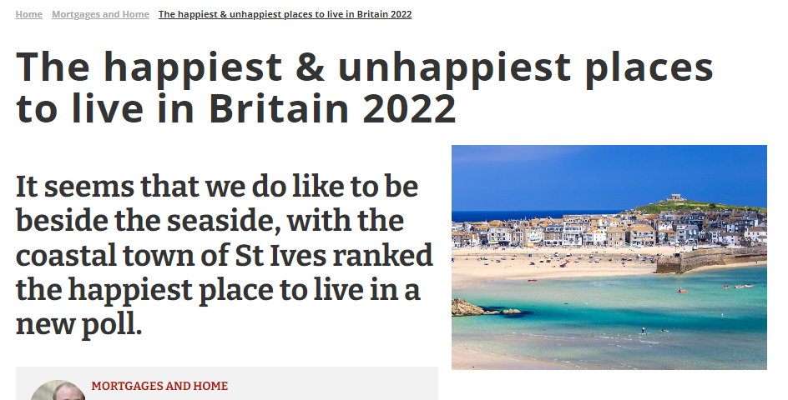
This is why we should be wary of media reports like this:
The “extreme” scores are most likely to come from SMALL samples. i.e. towns like St Ives and Colchester, not cities like Manchester or Birmingham.

Slide 52
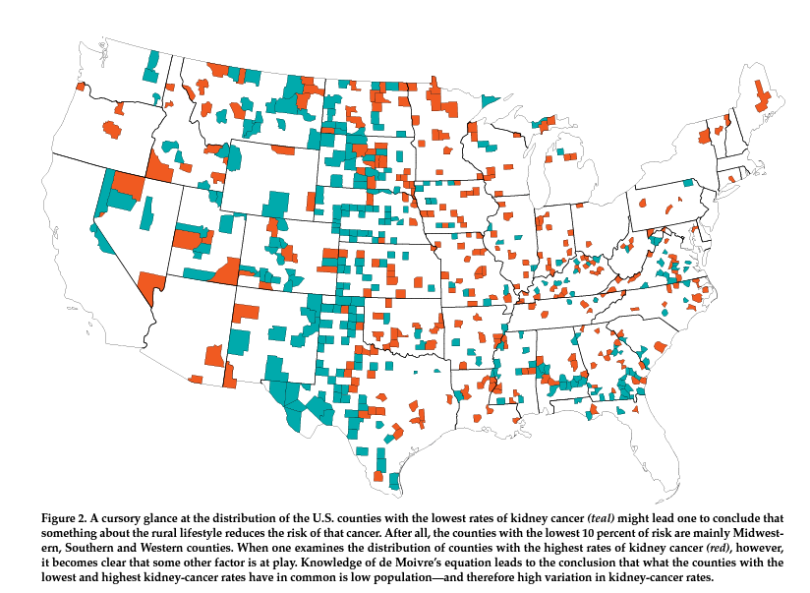
Another (more serious) example
Map of kidney cancer rates in the States.
Blue (teal) shows the areas with particularly low rates of kidney cancer.
Why might this be?
Red shows the areas with particularly high rates of kidney cancer.
What do you conclude now?

Slide 53
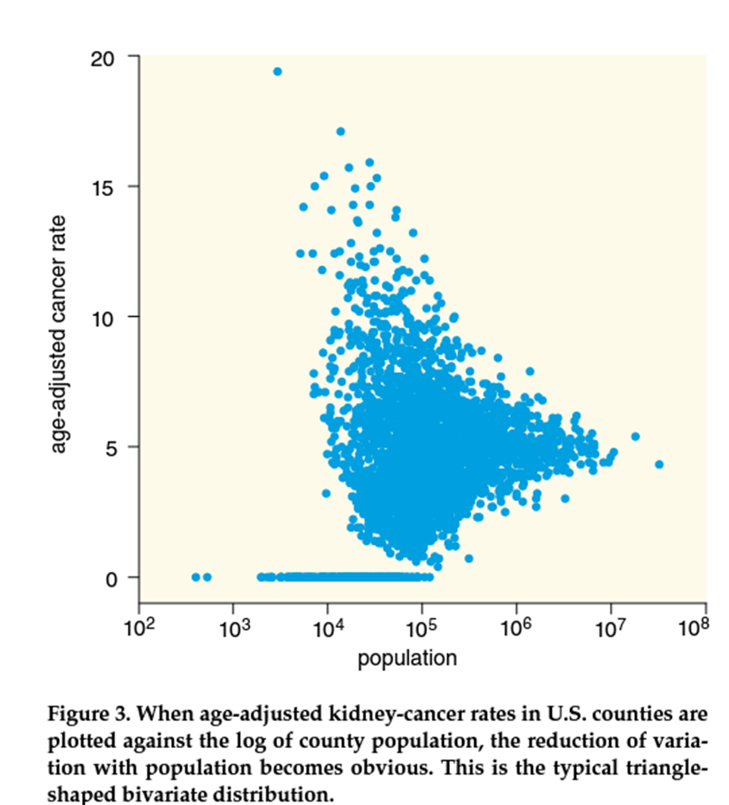
Plot of rates of cancer, based on population.
Here you can see that larger populations give more accurate estimates.
So areas within the same state show the highest AND the lowest rates of cancer, because those states have the lowest populations.

Slide 54
The opposite is to believe in larger samples.
E.g. Sir Francis Galton’s “wisdom of the crowd”
https://www.youtube.com/watch?v=uz5AeHqUtRs

Slide 55
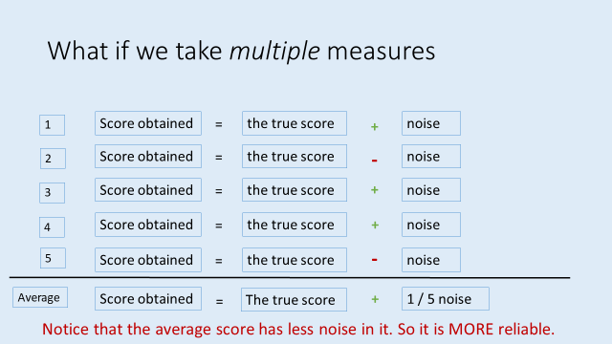
Wisdom of the (large) crowd
In the jelly bean example (or the original Cow example from Galton), the average is taken over a LARGE sample (160 in this case), and the result is a quite accurate average.
This implies that all people have some accuracy buried in lots of noise.
Averaging a crowd gets rid of the noise, and reveals the underlying estimate.

Slide 56
Wisdom of the (large) crowd
Another example comes from gambling / bookmaker’s odds.
One way of predict who will win a race (or an election) is to follow the money.
Each person might make a poor prediction, but the results of LOTS of bets can be quite accurate.
Bookmakers odds reflect where the money is placed.

Slide 57
Imagine we had 3 thermometers (T1, T2, T3), measuring a range of temperatures. We then correlate the temperatures from each thermometer with the others.
Which Thermometer is faulty?
What evidence points to this?

Slide 58
What is the difference between these 2 scenarios?

Slide 59
What is the difference between these 2 scenarios?
Here, T3 is unreliable. It doesn’t correlate with itself (and so it can’t correlate reliably with anything else)
Here, T3 is reliable. It correlates with itself but not with the other Thermometers.
T3 lacks validity.

Slide 60
Validity
Is the extent to which a measure, measures what it is supposed to.
i.e. that a thermometer measures temperature
that an extraversion test measures extraversion
that a spatial skill test measures spatial skill

Slide 61
Four kinds of validity (only 2 can be tested)
1: Face validity
Does the measure look right?
e.g. does a spatial skill measure have questions that test spatial ability rather than other kinds of ability.

Slide 62
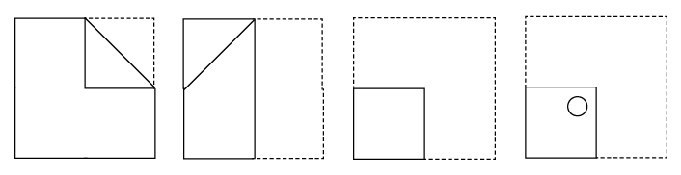
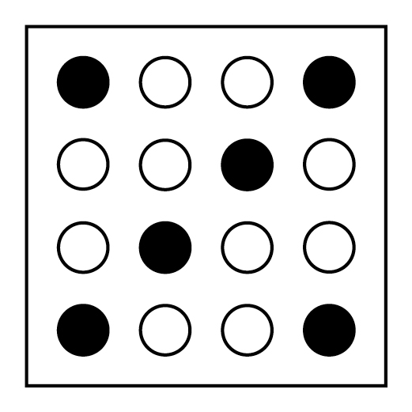
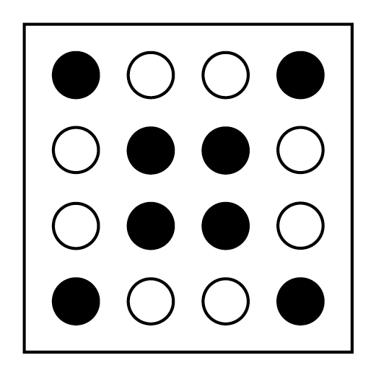
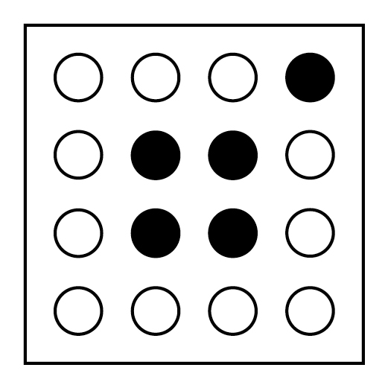
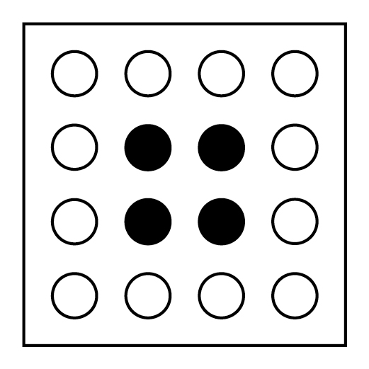
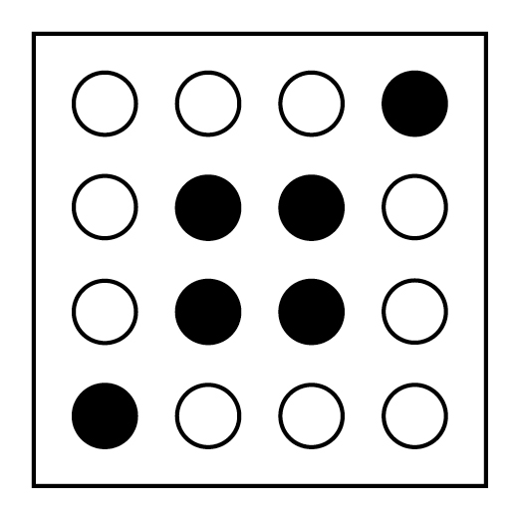
Imagine a paper is folded, then a hole punched through.
When unfolded, what will the pattern of holes look like (shaded dark below)

Slide 63
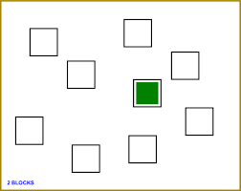
Four kinds of validity (only 2 can be tested)
2: Content validity
Does the measure sample all aspects of the construct?
e.g. for spatial skill, it might involve:
paper folding
mental rotation
spatial working memory capacity
remembering routes (etc)

Slide 64
Four kinds of validity (only 2 can be tested)
3: Predictive validity
Does the measure predict outcomes that are expected
e.g. a valid measure of spatial skill, should predict:
performance on other tests of spatial skill
differences between people we expect to vary in spatial skill (e.g. architects vs non-architects)

Slide 65
Four kinds of validity (only 2 can be tested)
4: Discriminant validity
Is the measure insensitive to factors that are unrelated to the construct being measured.
e.g. a valid measure of spatial skill, should NOT be related
to performance on a verbal reasoning task
should not relate to extraversion / introversion

Slide 66
Convergent and discriminant validity
Are measures of the correlation between the test and other measures.
Correlations that should be observed (convergent validity)
Correlations that should not be observed (discriminant validity)

Slide 67
Improving validity
Imagine you had a 4 measures of a construct (Measures 1-4).
You correlate each score with the average of the remainder.
i.e. correlate Score 1 with the average of 2,3 and 4
correlate Score 2 with the average or 1, 3 and 4
etc.

Slide 68
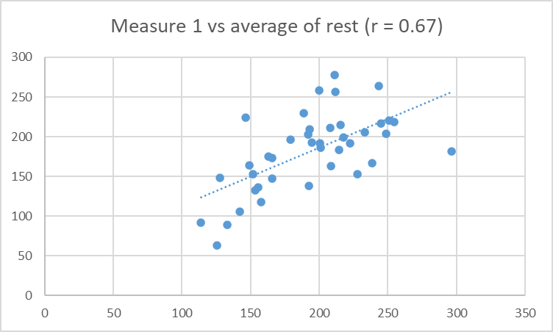
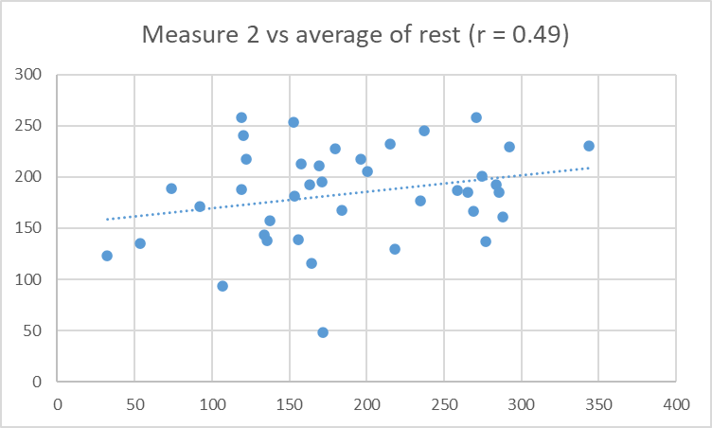
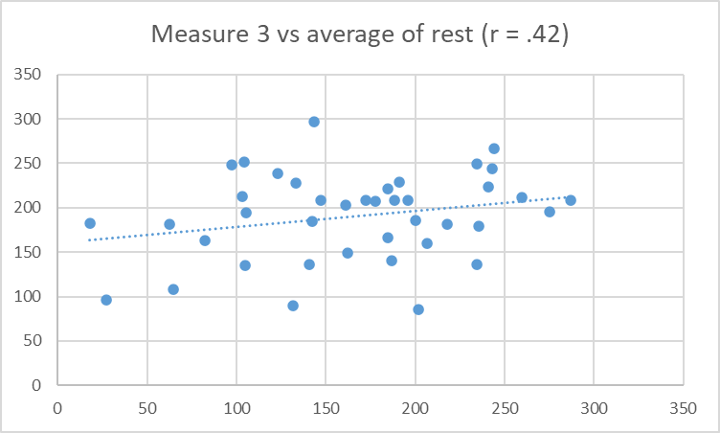
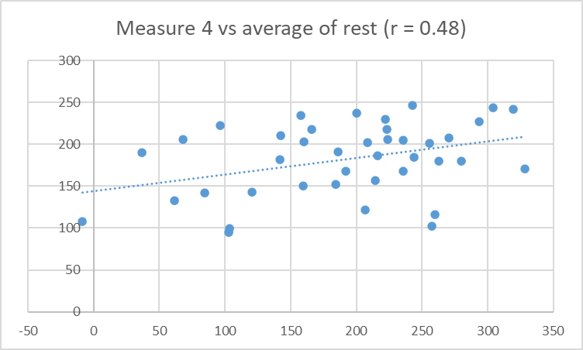
Imagine this was the outcome: Which is the best measure?

Slide 69
Imagine this was the outcome: Which is the best measure?
Measure 1 correlates (= predicts) the average of the remainder, better than any other measure does. It is the “best” measure of these 4 scores of whatever these tests share.

Slide 70
Personality

Slide 71
Psychometrics of personality tests
Woodworth Personal Data Sheet (1919)
Myers-Briggs (1944)
NEO (1985, 1992, 2005)
Available online: https://bigfive-test.com
Good reliability
Less poor validity

Slide 72
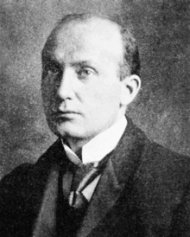
Psychometrics of personality tests
Woodworth Personal Data Sheet (1919)
Where it all began
Example items
1. Do you usually feel well and strong? (reverse scored) Yes
4. Are you troubled with dreams about your work? No
25. Have you ever fainted away? No
110. Has any of your family committed suicide? No
116. Do you like outdoor life? (reverse scored) Yes

Slide 73
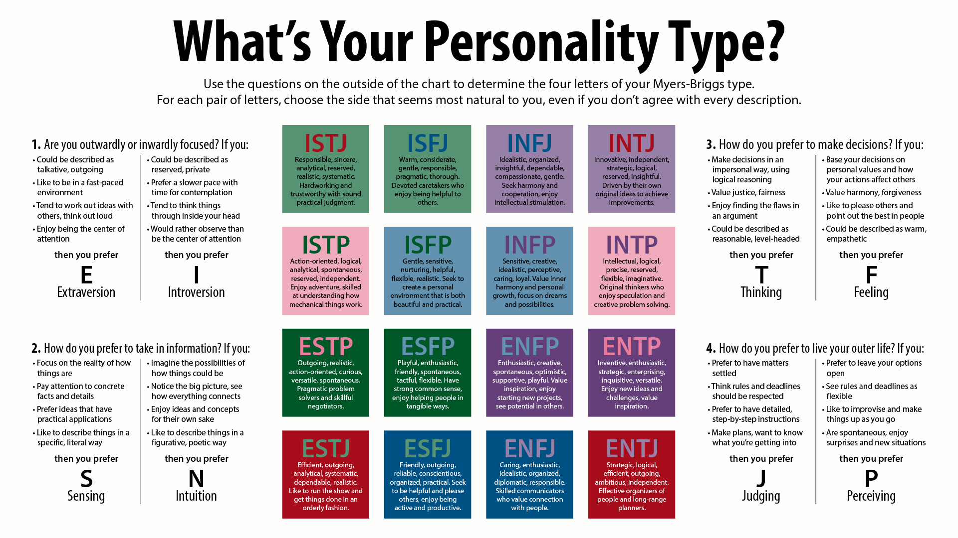
Psychometrics of personality
- Myers-Briggs
Myers-Briggs
Popular online
Poor reliability
Poor validity
Personality is not dichotomous!

Slide 74
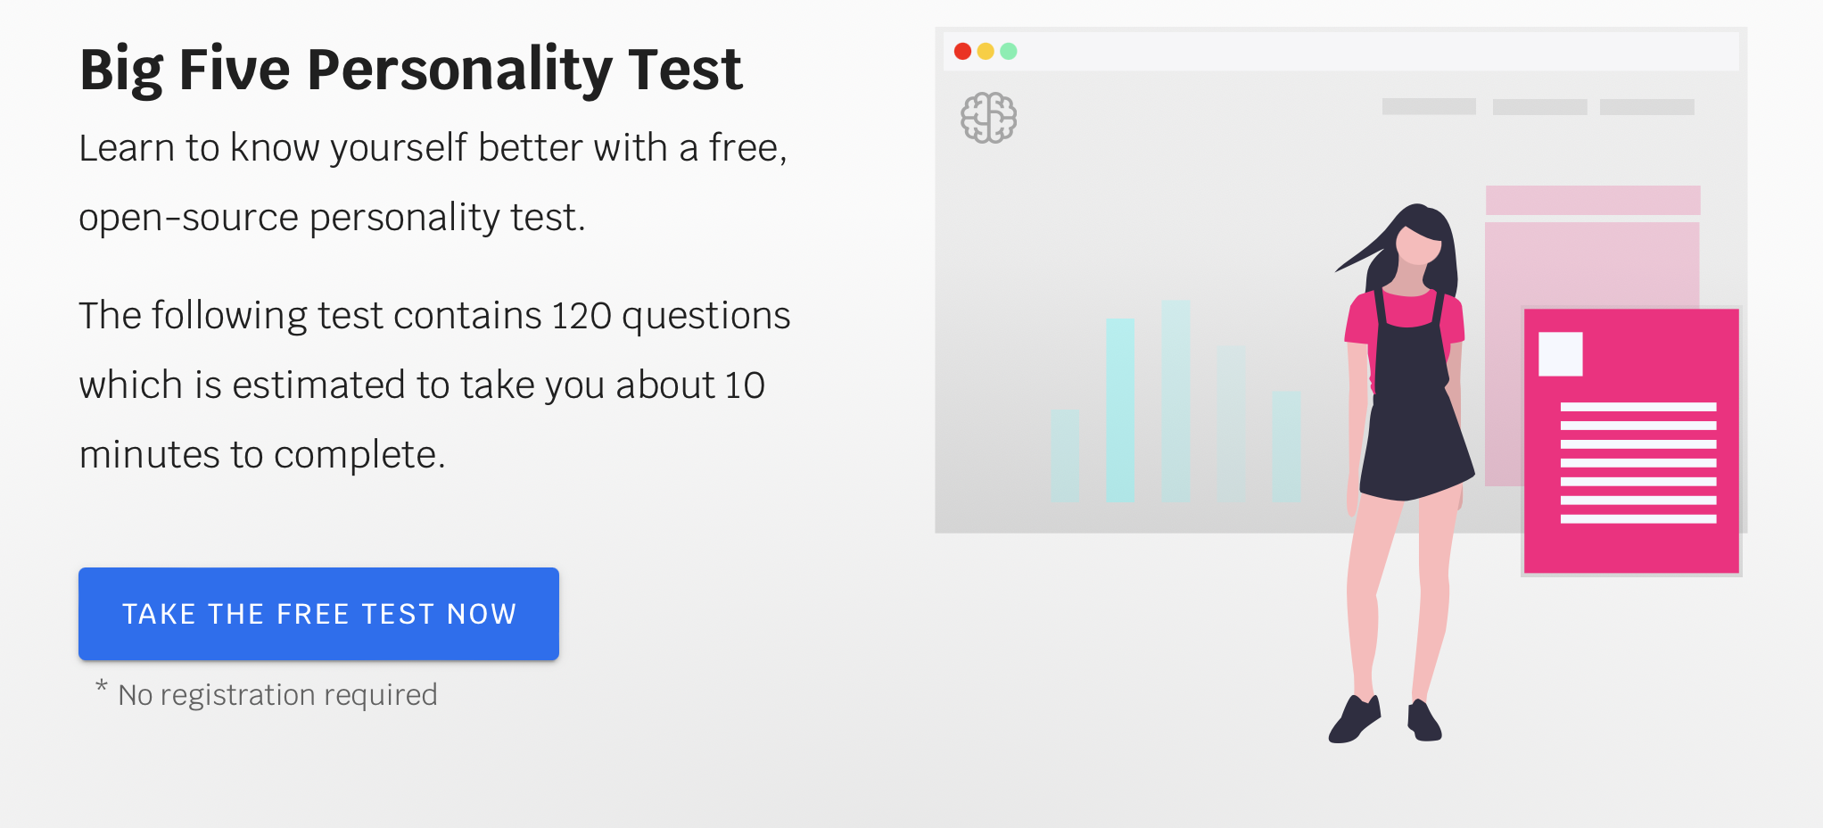
Psychometrics of personality tests
NEO (1985, 1992, 2005)
Available online: https://bigfive-test.com
Based on the now-standard Five Factor model
Good reliability
Less poor validity
Openness to experience
Conscientiousness
Extraversion
Agreeableness
Neuroticism

Slide 75
Psychometrics of almost anything!
There are good, free, tests for almost anything: https://ipip.ori.org
This alphabetical lit might be particularly helpful:
https://ipip.ori.org/newIndexofScaleLabels.htm

